Slide 1
Binary Representation
by
Dr. Md. Rajibul Islam
CSE, UAP

Slide 2
Binary Representation

Slide 3
How a Decimal Number is Represented

Slide 4
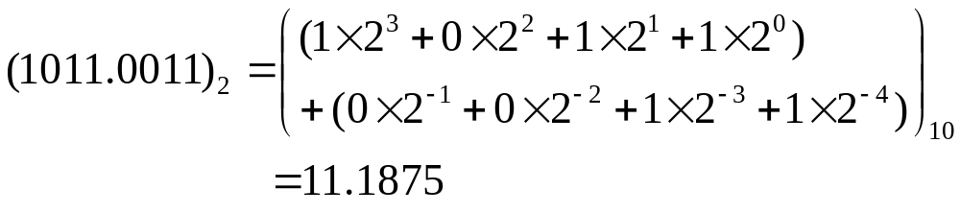
Base 2

Slide 5




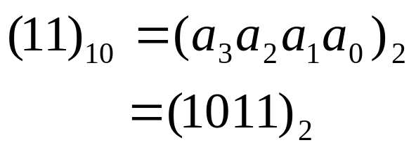
Convert Base 10 Integer to binary representation
Table 1 Converting a base-10 integer to binary representation.
 | Quotient | Remainder
11/2 | 5
5/2 | 2
2/2 | 1
1/2 | 0
Hence

Slide 6
Start
Input (N)₁₀
Integer N to be converted to binary format
i = 0
Divide N by 2 to get quotient Q & remainder R
i=i+1,N=Q
a_{i} = R
No
Is Q = 0?
Yes
n = i
(N)₁₀ = (a_{n}. . .a₀)₂
STOP

Slide 7








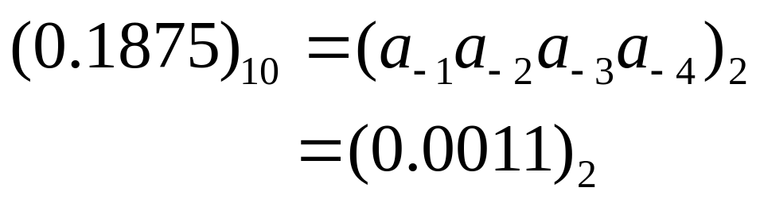
Fractional Decimal Number to Binary
Table 2. Converting a base-10 fraction to binary representation.
 | Number | Number after decimal | Number before decimal
 | 0.375 | 0.375
 | 0.75 | 0.75
 | 1.5 | 0.5
 | 1.0 | 0.0
Hence
Notes:
THG picture

Slide 8


Start
Input (F)₁₀
Fraction F to be converted to binary format
Multiply F by 2 to get number before decimal, S and after decimal, T
a_{i} = R
No
Is T =0?
Yes
n = i
(F)₁₀ = (a₋₁. . .a_{-n})₂
STOP

Slide 9
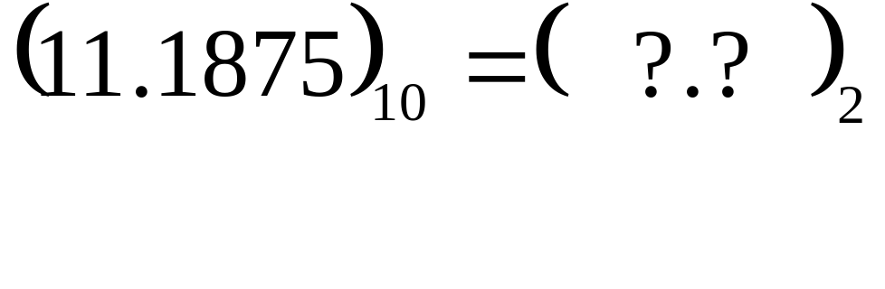
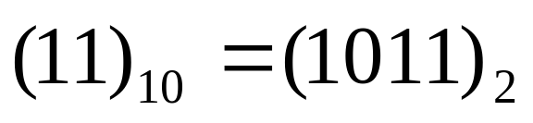
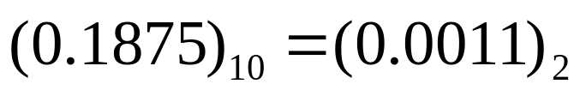
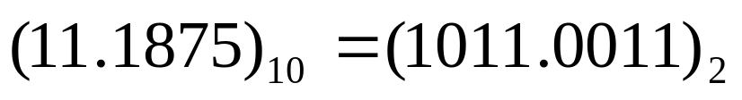
Decimal Number to Binary
Since
and
we have

Slide 10









All Fractional Decimal Numbers Cannot be Represented Exactly
Table 3. Converting a base-10 fraction to approximate binary representation.
 | Number | Number after decimal | Number before Decimal
 | 0.6 | 0.6
 | 1.2 | 0.2
 | 0.4 | 0.4
 | 0.8 | 0.8
 | 1.6 | 0.6

Slide 11
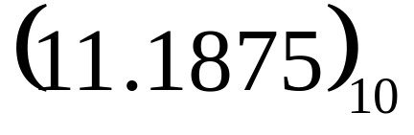
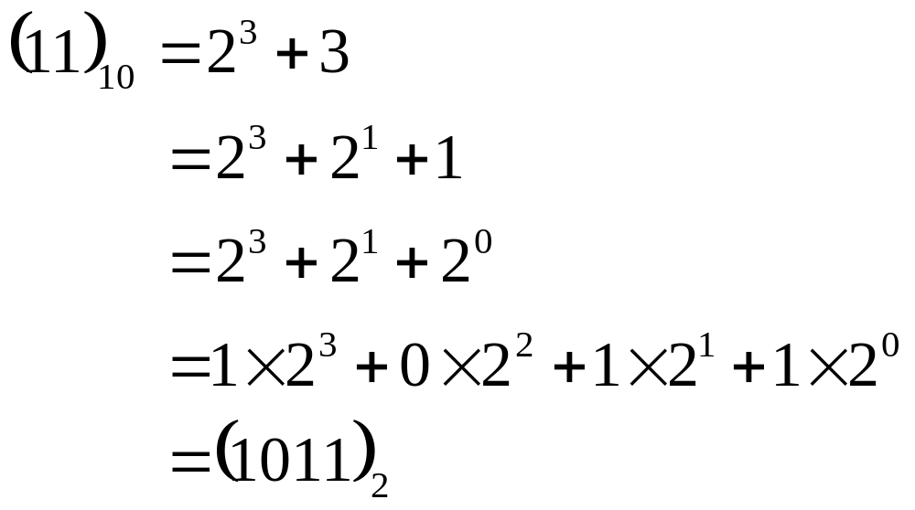
Another Way to Look at Conversion
Convert to base 2

Slide 12
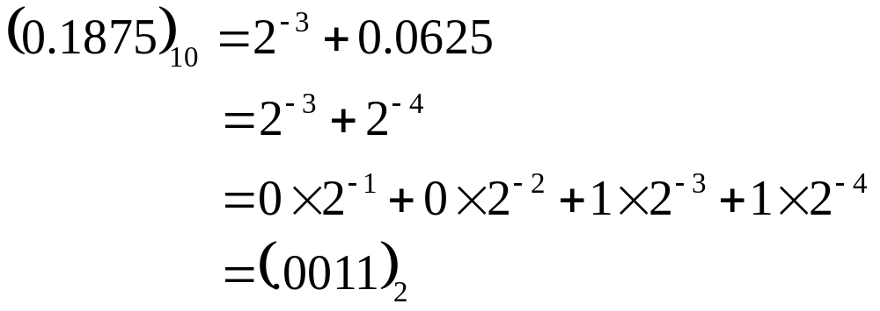
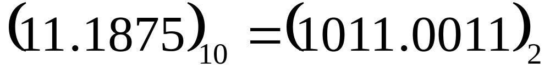

Slide 13
Additional Resources
Numerical Methods with Applications: Abridged (2nd Edition) – Autar Kaw, Egwu Kalu
  http://mathforcollege.com/nm/topics/textbook_index.html
Introductory Methods of Numerocal Analysis – S. S. Sastry
http://numericalmethods.eng.usf.edu

Slide 14
THE END

